Slide 1
Foundations of Software Engineering
605.601
Some Recent Trends in Software Project Success Rates & Estimation Techniques
Johns Hopkins University
Whiting School of Engineering
Engineering for Professionals
Joseph M. Demasco
2022
Notes:
In this course module we discussed a number of different techniques that have been developed to help in estimating effort, time, and cost in software projects. These techniques are not the only ones that exist, but they are relatively well-known in industry.
In this document we will present the results of some recent studies that investigated trends in the techniques that organizations use for estimating and a comparison of success rates and failure rates of projects over a 25-year period.

Slide 2
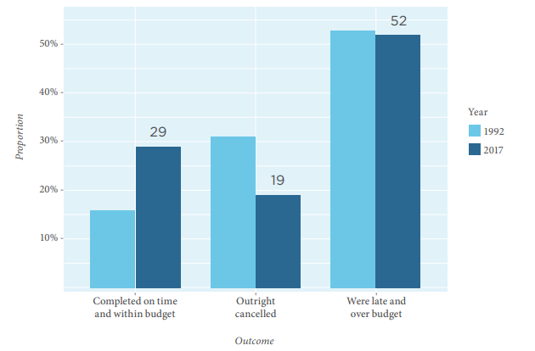
Success & Failure Rates Over 25 Years
Source: Reported in H. Krasner, “Quality Software in the U.S.: A 2018 Report,” Consortium for IT Software Quality (CITSQ), September 26, 2018.
Notes:
At the beginning of this course module I talked about some of the common problems associated with software projects and some remedies taken by project management when things go awry. But what I didn’t discuss was the question “how many projects do go awry and how many are successful?” There have been a number of studies done over the years that try to get some insight into this question. A report prepared for the Consortium for IT Software Quality presented in 2018 presented some interesting statistics that addressed this question.
This chart, taken from that report, shows some results of a study done by the Standish Group where they looked at 25 years of historical projects in their database, and they compared the percentage of projects that were completed on time and within budget, that were cancelled before completion, and were late and over budget. The data indicate that in 2017 19 percent of projects were cancelled, and 52 percent were late and over budget. If we call these “troublesome” projects, then 71 percent of the projects were in this category compared to 84 percent in 1992…and that’s really not that much of a change over the course of 25 years. While the percentage of projects that were cancelled appears to have decreased, the percentage of projects that were late and over budget is virtually the same.
So how come such a high percentage of projects are delivered late and over budget? There are likely several causal factors in play, for sure, and in my experience, and to stay focused on the topics in this course module, one of those factors is the failure to accurately estimate project effort and schedule. This course module presented a number of techniques that are used in project estimation, and we focused on elaborating the activity-based estimating approach, also called the bottom-up approach, because that can produce the most accurate estimates if used properly.

Slide 3

Most Commonly Used Estimating Techniques
94.2 %
82.6 %
75.6 %
J.B. Prater, K. Kirytopoulos, T. Ma, "An Investigation of Estimation Techniques for Information Technology Projects," IEEE Explore, February 2020
Notes:
Here are some results from a recent survey that sought to find out the most frequently used estimation techniques for IT projects.
There were 93 respondents to this survey, mostly based in Australia. The respondents were managers who had responsibility for project estimating in their organizations. The average project management experience of the respondents was more than 17 years.
As can be seen from the chart, the most frequently used technique was bottom-up…or activity-based…estimating, with 94.2 percent of respondents indicating they used this technique. The next two most frequently used techniques were expert judgement and analogy. The analogy approach involves consulting a database of historical information and developing estimates based upon analogous past projects.
There were other techniques reported in this survey, but the frequency of use dropped off considerably compared to these three.
Note that the percentages add up to more than 100 percent because respondents could use more than one technique.

Slide 4
What We Know & Don’t Know About Estimation
No significant improvement in estimating accuracy in several decades
Cost and effort overruns are still very common in software projects
Average overrun is about 30 percent
Statistical models don’t improve accuracy when compared to simpler models
Magne Jorgensen, "What We Do and Don't Know About Software Development Effort Estimation," IEEE Software, Volume 31, Issue 2, Mar-Apr 2014
Notes:
Another study cited here that was conducted to analyze what we know and don’t know about software project estimation has some interesting results.
This study compared the estimating accuracy reported in studies during the 1980s with more recent reports of estimating accuracy. A major conclusion was that there has been no significant improvement in estimation accuracy.
The researchers found overwhelming documented evidence that cost and effort overruns are very common, with the average overrun about 30 percent.
I think these two results tie nicely into the results presented in the 25 year study at the beginning of this document.
They also concluded that advanced statistical models don’t improve estimation accuracy when compared to simpler approaches…and this is something that I have experienced with my clients as well.

Slide 5
What We Know About Estimation
Sophisticated models don’t improve accuracy
Relevant historical data and checklists can improve estimation accuracy
Combining independent estimates improves accuracy
Minimum/maximum effort intervals are too narrow
Magne Jorgensen, "What We Do and Don't Know About Software Development Effort Estimation," IEEE Software, Volume 31, Issue 2, Mar-Apr 2014
Notes:
Here are some key things that the researchers said we do know about estimation.
Sophisticated models don’t improve accuracy. I’ve already mentioned this.
Historical data and checklists can improve accuracy. This takes some organizational commitment and management support in order to develop historical data bases. Checklists can be useful in helping to ensure that we don’t forget to include some key tasks that consume effort. I may have mentioned in one of the earlier lectures that not including all necessary tasks can be a driver in underestimating the effort that needs to be done.
Using multiple estimators who independently prepare estimates and share them with each other…like in a Delphi technique…can improve accuracy. When I talk to groups about the Delphi technique a question that often comes up has to do with whether one or more estimators can influence the estimator group in a negative way. One of the things they found in this study was that there is no documented evidence that the negative effect of “group think” is present in projects.
When estimators used approaches like estimating minimum and maximum effort, or used a 3-point approach, they found that the spread between the minimum and maximum estimates was often too narrow. In my own use of the 3-point technique I often found it challenging to estimate using a 95 or 99 percent confidence level and have switched to a lower confidence level like 75 or 80 percent. Also, incorporating a structured approach like Delphi can help to address this issue.

Slide 6
What We Don’t Know About Estimation
How to accurately estimate the effort of mega-large complex projects
How to measure software size and complexity for accurate estimation
How to measure and predict productivity
Magne Jorgensen, "What We Do and Don't Know About Software Development Effort Estimation," IEEE Software, Volume 31, Issue 2, Mar-Apr 2014
Notes:
And here are some things that the researchers say we don’t know about estimation.
I think these items are pretty self-explanatory. Developing a repository of historical data can certainly help with all of these items. You may recall that several of the estimation techniques presented in this module…like COCOMO and function points…were based on some type of size estimate…and needed to be calibrated to the specifics of each organization…so historical data can be a big help. Historical data can also be helpful when it comes to productivity.

Slide 7
Some Recommendations
Use simple estimation models tailored to local contexts in combination with expert judgement
Use historical estimation error
Use expert judgement and independent estimates to set minimum/maximum effort intervals
Use tailored checklists
Use structured, group-based estimation processes where independence of estimates is assured
Avoid early estimates based on highly incomplete information, if possible…and use probabilities, if necessary, to communicate uncertainties
Magne Jorgensen, "What We Do and Don't Know About Software Development Effort Estimation," IEEE Software, Volume 31, Issue 2, Mar-Apr 2014
Notes:
In conclusion…here are some recommendations that the researchers made and that I’ve extracted from some of the lectures in this course module. The items are self-explanatory, so I won’t elaborate on them.

